Slide 1
Boolean Functions
Exercise 8.1

Slide 2
Statement

Slide 3
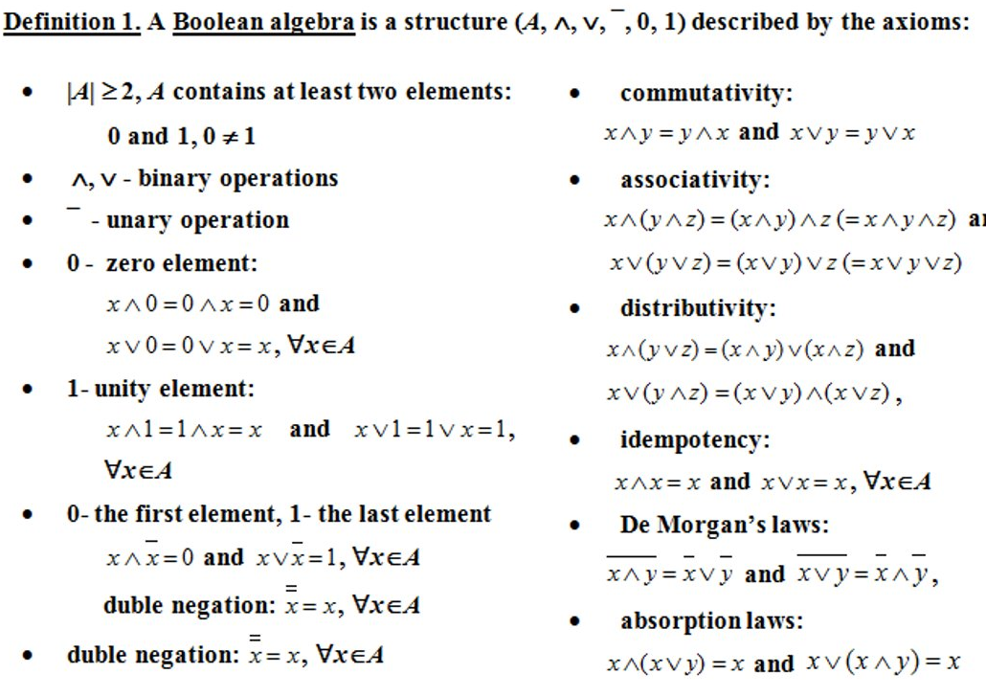
Theory

Slide 4
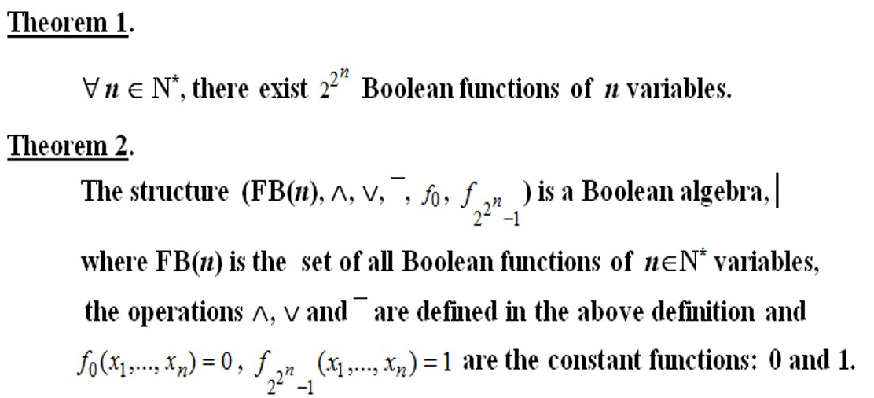
Theory

Slide 5
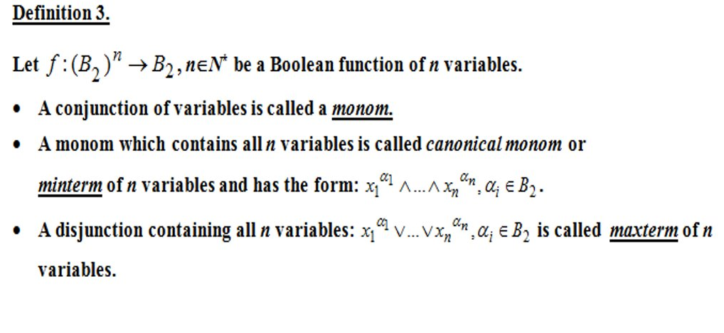
Theory

Slide 6
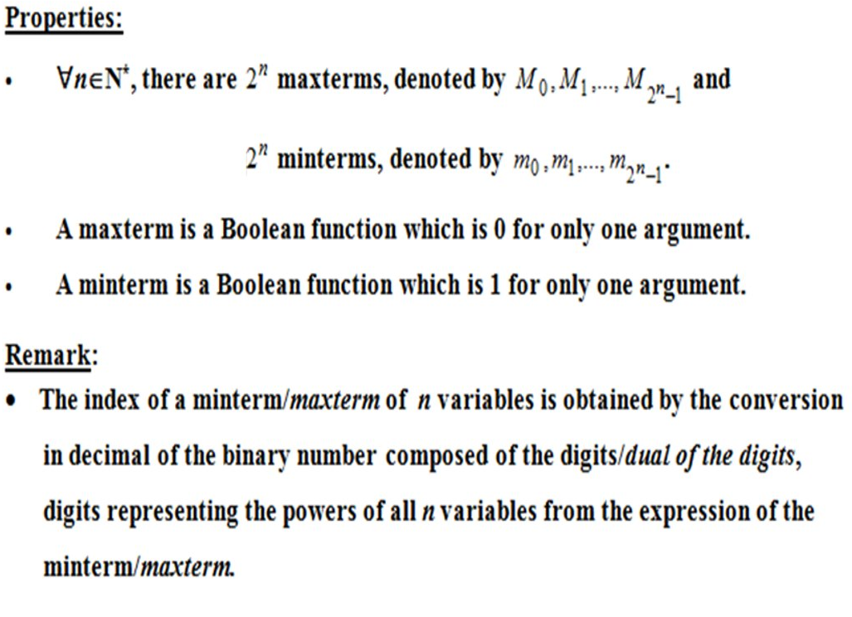
Theory

Slide 7
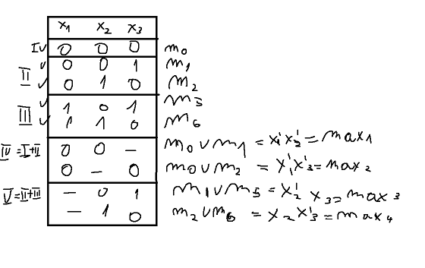
Solution
F1(x1,x2,x3)=m0 v m1 v m2 v m5 v m6= x1’x2’x3’ v x1’x2’x3v x1’x2x3’v x1x2’x3vx1x2x3’
Sf={(0,0,0),(0,0,1),(0,1,0),(1,0,1),(1,1,0)}-support of f
Sf={(0,0,0),(0,0,1),(0,1,0),(1,0,1),(1,1,0)}-sorted support

Slide 8
Solution
C(f)={max3,max4}
f₁^{s}:3 and, 2 or , 4 not\
f₂^{s}:3 and, 2 or , 4 not/
Pi :” maxi belongs to the simplified form of f”, i =1,2,3,4
“m0 covered by max1 or max2” p1vp2≡T
“m1 covered by max1 or max3” p1vp3≡T
“m2 covered by max2 or max4” p2vp4≡T
“m5 covered by max3” p3≡T
“m6 covered by max4” p4≡T
=>same efficiency

Slide 9
Solution
(p1vp2)^(p1vp3)^(p2vp4)^p3^p4 ≡T
P3^p4^(p1vp2) ≡T (applied absorption law)
T ≡(p1^p3^p4)v(p2^p3^p4) (applied distributive law)
DNF with 2 cubes
F₁^{s}(x1,x2,x3)=max1vmax3vmax4=x1’x2’ v x2’x3 v x2x3’
F₂^{s}(x1,x2,x3)=max2vmax3vmax4=x1’x3’ v x2’x3 v x2x3’

